Slide 1
Smart Street Lights
-A Step Towards A Cleaner Future
-By Krishna Srikar.D ,G.Sowrya, Anurag Reddy.K, Revanth.R, M.Sai Anuraag, T.Sandeep

Slide 2
About Our Project
Previously in many areas, Sodium street lamps are replaced by LED lights and this has resulted in saving a lot of energy.
Our idea is to further reduce wastage of energy by limiting the usage of street lights.
This helps much more in effectively reducing the amount of energy wasted

Slide 3
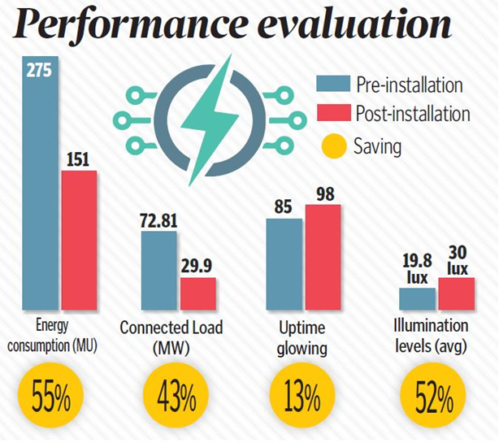
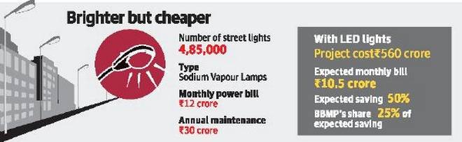
role of led lamps in saving energy in different cities
Bengaluru
Hyderabad

Slide 4
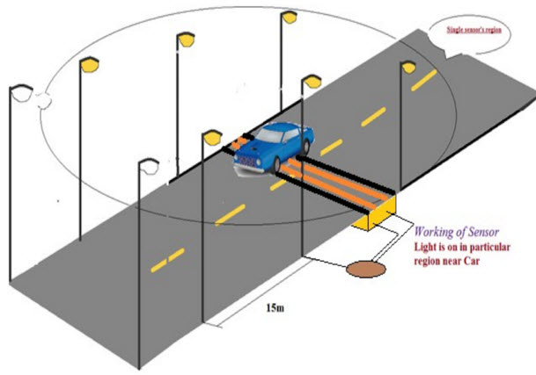
Idea of the project
The central idea of the project is to turn on the street lights only when a vehicle or person is near or directly under the street lamp.

Slide 5
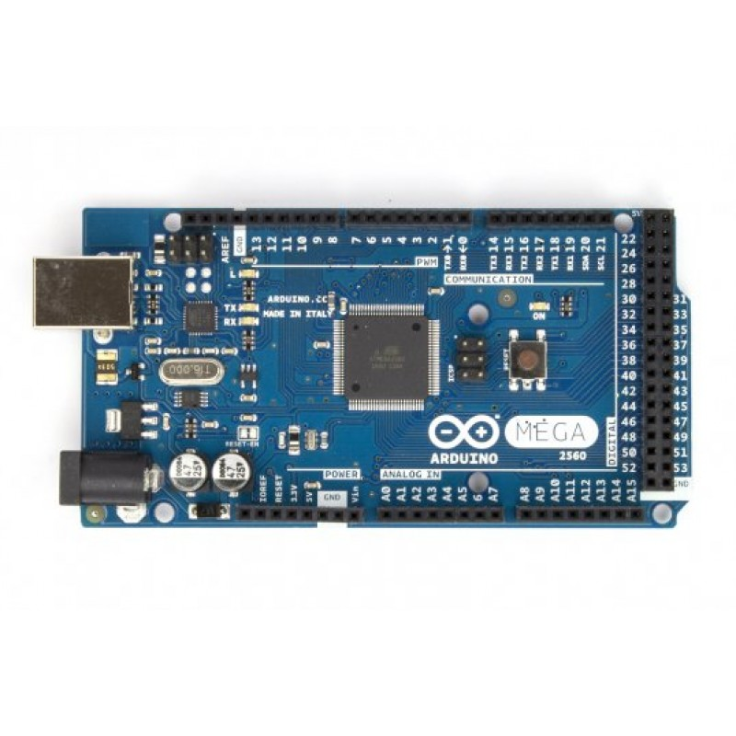
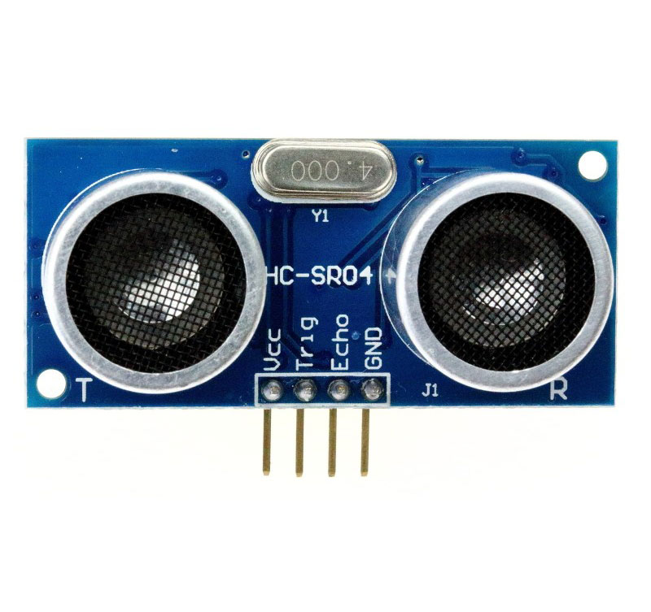
Apparatus used
Ultrasonic Sensors
LEDs
Setup for road
Arduino Mega 2560
Remote Controlled Car

Slide 6


